Slide 1
Unit 2 Data Link Layer
Data Link Layer is second layer of OSI Layered Model.
Data link layer hides the details of underlying hardware and represents itself to upper layer as the medium to communicate.
Data link layer is responsible for converting data stream to signals bit by bit and to send that over the underlying hardware. At the receiving end, Data link layer picks up data from hardware which are in the form of electrical signals, assembles them in a recognizable frame format, and hands over to upper layer.
Data link layer has two sub-layers:
Logical Link Control: It deals with protocols, flow-control, and error control.
Media Access Control: It deals with actual control of media.

Slide 2
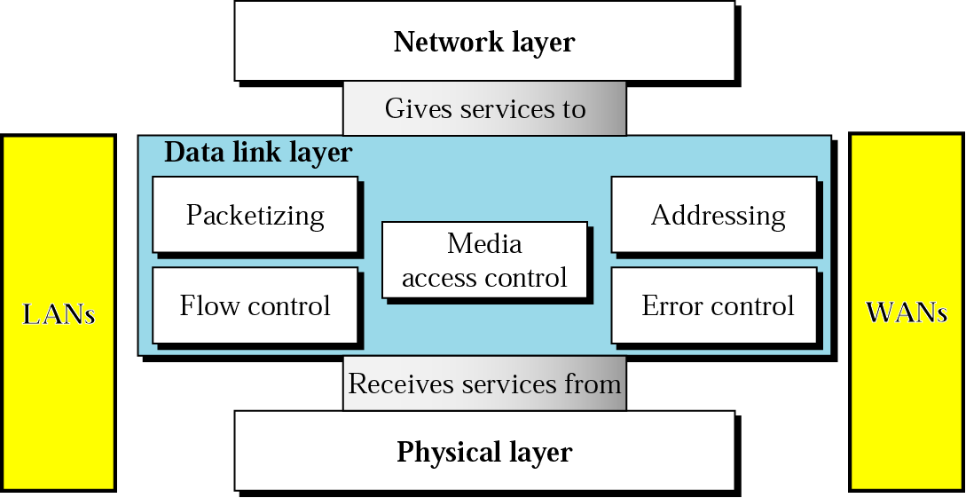
Data Link Layer

Slide 3
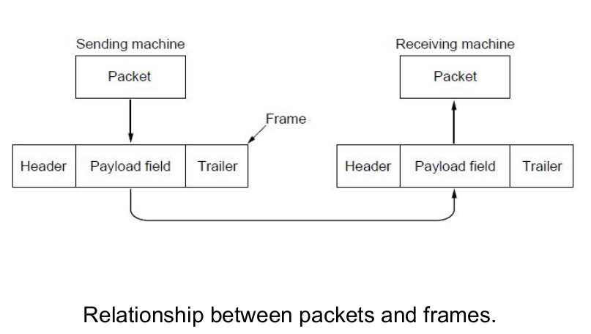
Functions of Data Link Layer:
Physical layer delivers bits of information to and from data link layer. The functions of Data Link Layer are:
1. Providing a well-defined service interface to the network layer.
2. Dealing with transmission errors.
3. Regulating the flow of data so that slow receivers are not swamped by fast senders.
4. Data Link layer Takes the packets from Physical layer, and Encapsulates them into frames
5. Each frame has a frame header – a field for
holding the packet, and frame trailer.
6. Frame Management is what Data Link Layer does.

Slide 4
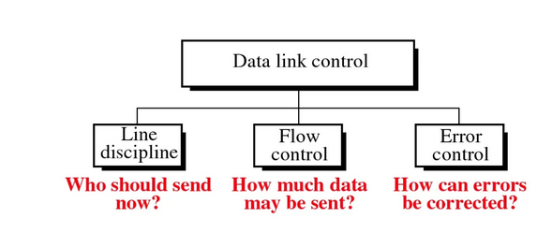
Data Link Layer Design Issues
Services Provided to the Network Layer
Framing
Error control
Flow control

Slide 5
Services Provided to the Network Layer
Principal Service Function of the data link layer is to transfer the data from the network layer on the source machine to the network layer on the destination machine.
– Process in the network layer that hands some bits to the data
link layer for transmission.
– Job of data link layer is to transmit the bits to the destination
machine so they can be handed over to the network layer there
(see figure in the next slide).

Slide 6
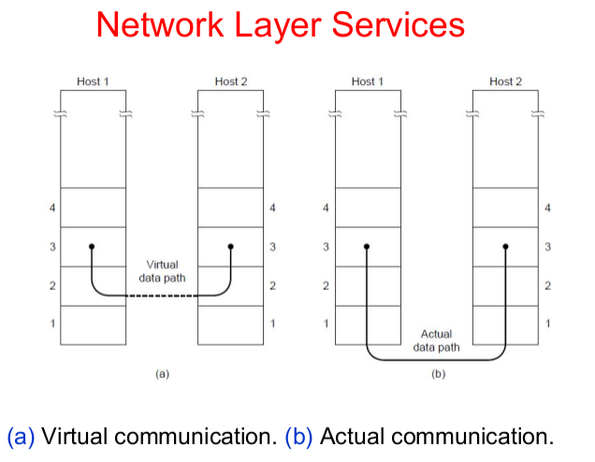

Slide 7
Possible Services Offered to Network Layer
1. Unacknowledged connectionless service: source machine send independent frames to the destination machine without having the destination machine acknowledge them.
• Example: Ethernet, Voice over IP, etc.
2. Acknowledged connectionless service: Each frame send by the Data Link layer is acknowledged and the sender knows if a specific frame has been received or lost.This service is useful for commutation when an unreliable channel is being utilized (e.g., 802.11 WiFi).

Slide 8
3. Acknowledged connection-oriented service:
Source and Destination establish a connection first.
• Each frame sent is numbered
– Data link layer guarantees that each frame sent is indeed
received.
– It guarantees that each frame is received only once and that all
frames are received in the correct order.
• Examples:
– Satellite channel communication,Long-distance telephone communication, etc.
• Three distinct phases: 1. Connection is established 2. One or more frames are transmitted. 3. Finally, the connection is released

Slide 9
2. Framing
To provide service to the network layer the data link layer must use the service provided to it by physical layer.
• Stream of data bits provided to data link layer is not guaranteed to be without errors.
• Errors could be:
– Number of received bits does not match number of transmitted bits (deletion or insertion)
– Bit Value
• It is up to data link layer to correct the errors if necessary.

Slide 10
Transmission of the data link layer starts with breaking up the bit stream
– into discrete frames
– Computation of a checksum for each frame, and
– Include the checksum into the frame before it is transmitted.
• Receiver computes its checksum error for a receiving frame and if it is different from the checksum that is being transmitted will have to deal with the error.
Framing Methods :
Byte count.
Flag bytes with byte stuffing.
Flag bits with bit stuffing.
Physical layer coding violations.

Slide 11
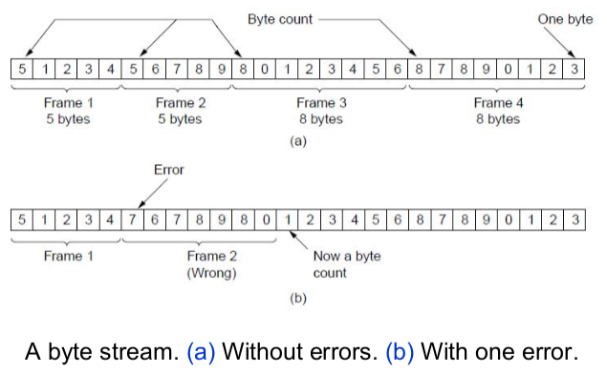
Byte count:
• It uses a field in the header to specify the number of bytes in the frame.
• Once the header information is being received it will be used to determine end of the frame.
See figure in the next slide:
• Trouble with this algorithm is that when
the count is incorrectly received the
destination will get out of synch with transmission.
– Destination may be able to detect that the
frame is in error but it does not have a means
(in this algorithm) how to correct it.

Slide 12
2. Flag bytes with byte stuffing (Character Stuffing)
In the data link layer, a flag is a special bit or byte sequence used to mark the beginning and end of a frame, acting as a delimiter to separate individual data frames.
This is crucial for the receiver to correctly identify where one frame ends and the next begins, especially in continuous data streams.
Purpose:
Flags are used to delineate the boundaries of a data frame, indicating where the frame starts and ends.
Format:
In many protocols, like HDLC, the flag is a specific bit pattern, such as 01111110

Slide 13
Cont..
Character/Bit Stuffing:
Character stuffing is also known as byte stuffing or character-oriented framing and is same as that of bit stuffing but byte stuffing actually operates on bytes whereas bit stuffing operates on bits.
If the actual data within a frame contains the same bit pattern as the flag, a process called "bit stuffing" or "byte stuffing" is used to avoid misinterpretation.
This involves inserting an extra bit (bit stuffing) or byte (byte stuffing) to differentiate it from the flag sequence.

Slide 14
Cont..
In byte stuffing, special byte that is basically known as ESC (Escape Character) that has predefined pattern is generally added to data section of the data stream or frame when there is message or character that has same pattern as that of flag byte.
But receiver removes this ESC and keeps data part that causes some problems or issues.
In simple words, we can say that character stuffing is addition of 1 additional byte if there is presence of ESC or flag in text.

Slide 15
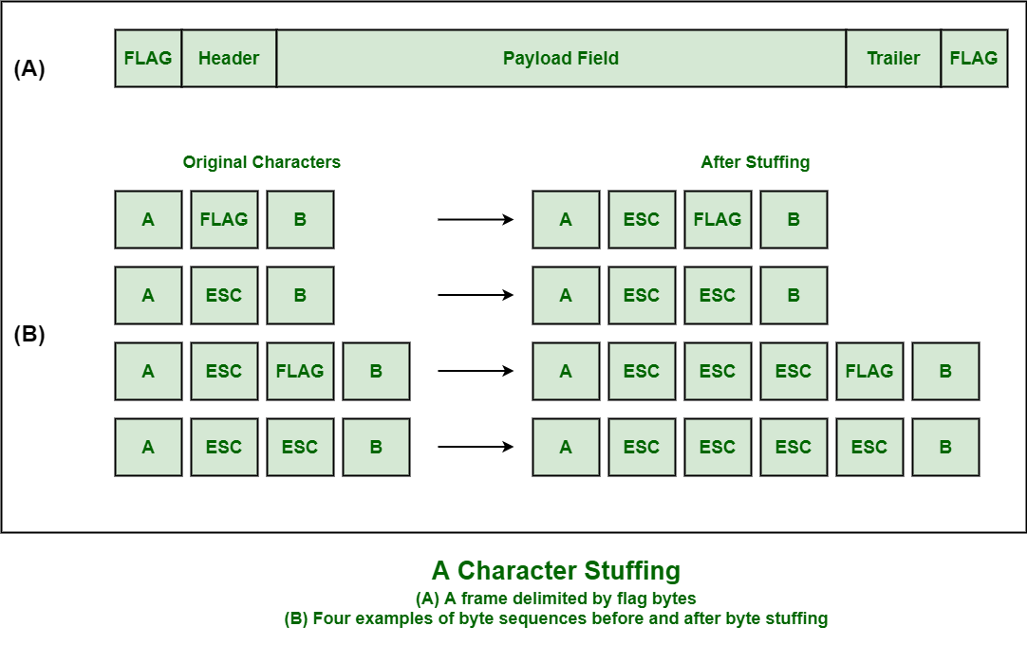

Slide 16
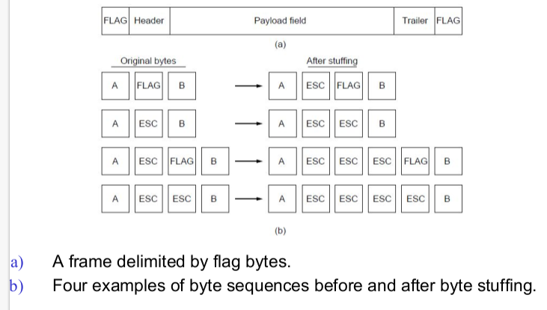
Cont..
This methods gets around the boundary detection of the frame by having each appended by the frame start and frame end special bytes.
• If they are the same (beginning and ending byte in the frame) they are called flag byte.
• In the figure this byte is shown as
FLAG.
• If the actual data contains a byte that is
identical to the FLAG byte (e.g., picture,
data stream, etc.) the convention that
can be used is to have escape character
inserted just before the
“FLAG” character.

Slide 17
Flag bits with bit stuffing:
Bit stuffing is also known as bit-oriented framing or bit-oriented approach. In bit stuffing, extra bits are being added by network protocol designers to data streams.
It is generally insertion or addition of extra bits into transmission unit or message to be transmitted as simple way to provide and give signaling information and data to receiver and to avoid or ignore appearance of unintended or unnecessary control sequences.
It is type of protocol management simply performed to break up bit pattern that results in transmission to go out of synchronization.
Bit stuffing is very essential part of transmission process in network and communication protocol. It is also required in USB.

Slide 18
3. Flag bits with bit stuffing:
This methods achieves the same thing as Byte Stuffing method by using Bits (1) instead of Bytes (8 Bits).
• It was developed for High-level Data Link Control (HDLC) protocol.
• Each frames begins and ends with a special bit patter:
– 01111110 or 0x7E <- Flag Byte
– Whenever the sender’s data link layer encounters five consecutive 1s in the data it automatically stuffs a 0 bit into the outgoing bit stream.
– USB uses bit stuffing.

Slide 19
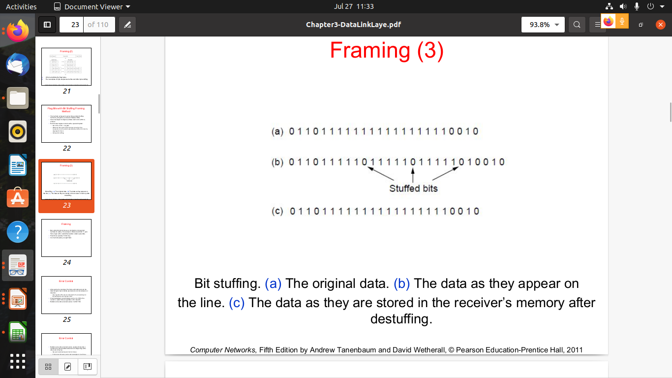

Slide 20
4. Physical layer coding violations.
Encoding violation is method that is used only for network in which encoding on physical medium includes some sort of redundancy i.e., use of more than one graphical or visual structure to simply encode or represent one variable of data.

Slide 21
Error Control
Data-link layer uses the techniques of error control simply to ensure and confirm that all the data frames or packets, i.e. bit streams of data, are transmitted or transferred from sender to receiver with certain accuracy.
Error control is basically process in data link layer of detecting or identifying and re-transmitting data frames that might be lost or corrupted during transmission.
In both of these cases, receiver or destination does not receive correct data frame and sender or source does not even know anything about any such loss regarding data frames.
Therefore, in such type of cases, both sender and receiver are provided with some essential protocols that are required to detect or identify such types of errors as loss of data frames.

Slide 22
Cont..
The Data-link layer follows a technique known as re-transmission of frames to detect or identify transit errors and also to take necessary actions that are required to reduce or remove such errors.
Each and every time an error is detected during transmission, particular data frames are retransmitted and this process is known as ARQ (Automatic Repeat Request).
There are basically two ways of doing Error control as given below :

Slide 23
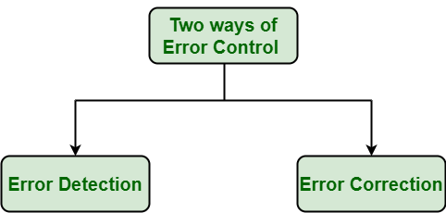

Slide 24
Cont..
Error Detection :
Error detection, as the name suggests, simply means detection or identification of errors.
These errors may occur due to noise or any other impairments during transmission from transmitter to the receiver, in communication system.
It is a class of techniques for detecting garbled i.e. unclear and distorted data or messages.
Error Correction : Error correction, as the name suggests, simply means correction or solving or fixing of errors.
It simply means reconstruction and rehabilitation of original data that is error-free.
But error correction method is very costly and very hard.

Slide 25
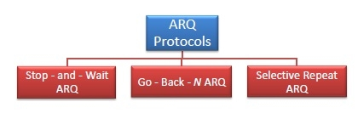
ARQ strategies
Various Techniques for Error Control : There are various techniques of error control as given below :
Automatic Repeat ReQuest (ARQ) is a group of error – control protocols for transmission of data over noisy or unreliable communication network.

Slide 26
1. Stop-and-Wait ARQ (Automatic Repeat Request) :
Stop-and-Wait ARQ is also known as alternating bit protocol. It is one of the simplest flow and error control techniques or mechanisms.
This mechanism is generally required in telecommunications to transmit data or information between two connected devices.
Receiver simply indicates its readiness to receive data for each frame.
In these, sender sends information or data packets to receiver.
Sender then stops and waits for ACK (Acknowledgment) from receiver.
Further, if ACK does not arrive within given time period i.e., time-out, sender then again resends frame and waits for ACK.
But, if sender receives ACK, then it will transmit the next data packet to receiver and then again wait for ACK from receiver.
This process to stop and wait continues until sender has no data frame or packet to send.

Slide 27
Sliding Window ARQ (Automatic Repeat Request)
Go-Back-N ARQ :
Go-Back-N ARQ is form of ARQ protocol in which transmission process continues to send or transmit total number of frames that are specified by window size even without receiving an ACK (Acknowledgement) packet from the receiver.
It uses sliding window flow control protocol. If no errors occur, then operation is identical to sliding window

Slide 28
Cont..
Selective Repeat ARQ :
Selective Repeat ARQ is also form of ARQ protocol in which only suspected or damaged or lost data frames are only retransmitted.
This technique is similar to Go-Back-N ARQ though much more efficient than the Go-Back-N ARQ technique due to reason that it reduces number of retransmission.
In this, the sender only retransmits frames for which NAK is received.
But this technique is used less because of more complexity between sender and receiver and each frame must be needed to be acknowledged individually

Slide 29
Cont..
The main difference between Go Back ARQ and Selective Repeat ARQ is that in Go Back ARQ, the sender has to retransmit the whole window of frame again if any of the frame is lost but in Selective Repeat ARQ only the data frame that is lost is retransmitted

Slide 30
Error Control
• After solving the marking of the frame with start and end the data link layer has to handle eventual errors in transmission or detection.
– Ensuring that all frames are delivered to the network layer at the destination and in proper order.
• Unacknowledged connectionless service: it is OK for the sender to output frames regardless of its reception.
• Reliable connection-oriented service: it is NOT OK.Error Control
• Reliable connection-oriented service usually will provide a sender with some feedback about what is happening at the other end of the line.
– Receiver Sends Back Special Control Frames.
– If the Sender Receives positive Acknowledgment it will know that the frame has arrived safely.
• Timer and Frame Sequence Number for the Sender is Necessary to handle the case when there is no response (positive or negative) from the Receiver .

Slide 31
Flow Control
Flow control in computer networks is a mechanism that regulates the rate of data transmission between devices to prevent a fast sender from overwhelming a slow receiver.
It ensures that the sender doesn't send data faster than the receiver can process, thus avoiding data loss and maximizing network performance.
Essentially, it's a way to match the sender's speed with the receiver's capacity.

Slide 32
Cont..
Why is flow control needed?
Preventing buffer overflows:
If a sender transmits data too quickly, the receiver's buffer can overflow, leading to lost packets and the need for retransmissions.
Optimizing network performance:
By ensuring the sender and receiver are synchronized, flow control helps avoid unnecessary retransmissions and maximizes the efficient use of network resources.
Maintaining data integrity:
It ensures that data is received correctly without being corrupted or lost due to the receiver being unable to keep up.

Slide 33
Cont..
How does flow control work?
Flow control mechanisms typically involve the receiver sending signals (acknowledgements or feedback) to the sender to indicate its ability to receive data. The sender then adjusts its transmission rate based on these signals.

Slide 34
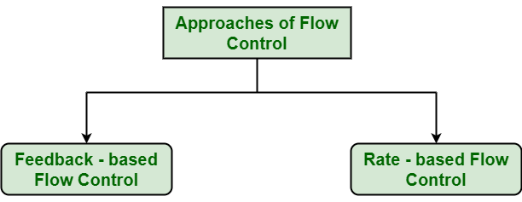

Slide 35
Cont..
Feedback - based Flow Control :
In this control technique, sender simply transmits data or information or frame to receiver, then receiver transmits data back to sender and also allows sender to transmit more amount of data or tell sender about how receiver is processing or doing.
This simply means that sender transmits data or frames after it has received acknowledgements from user.

Slide 36
Cont..
Rate – based Flow Control :
In this control technique, usually when sender sends or transfer data at faster speed to receiver and receiver is not being able to receive data at the speed, then mechanism known as built-in mechanism in protocol will just limit or restricts overall rate at which data or information is being transferred or transmitted by sender without any feedback or acknowledgement from receiver.
Built in mechanism that limits the rate at which sender may transmit data, without the need for feedback from the receiver.

Slide 37
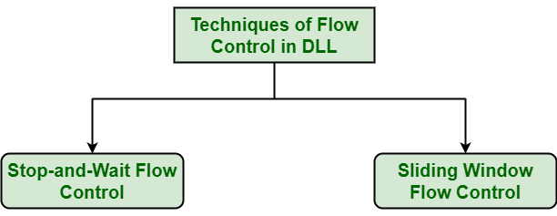

Slide 38
1. Stop-and-Wait Flow Control :
This method is the easiest and simplest form of flow control.
In this method, basically message or data is broken down into various multiple frames, and then receiver indicates its readiness to receive frame of data.
When acknowledgement is received, then only sender will send or transfer the next frame.
This process is continued until sender transmits EOT (End of Transmission) frame.
In this method, only one of frames can be in transmission at a time.
It leads to inefficiency i.e. less productivity if propagation delay is very much longer than the transmission delay and Ultimately In this method sender sent single frame and receiver take one frame at a time and sent acknowledgement(which is next frame number only) for new frame.

Slide 39
Cont..
Advantages -
This method is very easiest and simple and each of the frames is checked and acknowledged well.
This method is also very accurate.
Disadvantages -
This method is fairly slow.
In this, only one packet or frame can be sent at a time.
It is very inefficient and makes the transmission process very slow.

Slide 40
Sliding Window Flow Control :
In this method, sender transmits or sends various frames or packets before receiving any acknowledgement.
In this method, both the sender and receiver agree upon total number of data frames after which acknowledgement is needed to be transmitted.
Data Link Layer requires and uses this method that simply allows sender to have more than one unacknowledged packet “in-flight” at a time.
This increases and improves network throughput. and Ultimately In this method sender sent multiple frame but receiver take one by one and after completing one frame acknowledge(which is next frame number only) for new frame.

Slide 41
Cont..
Advantages -
It performs much better than stop-and-wait flow control.
This method increases efficiency.
Multiples frames can be sent one after another.
Disadvantages -
The main issue is complexity at the sender and receiver due to the transferring of multiple frames.
The receiver might receive data frames or packets out the sequence.

Slide 42
Flow control | Error control
Flow control is meant only for the transmission of data from sender to receiver. | Error control is meant for the transmission of error free data from sender to receiver.
For Flow control there are two approaches : Feedback-based Flow Control and Rate-based Flow Control. | To detect error in data, the approaches are : Checksum, Cyclic Redundancy Check and Parity Checking. To correct error in data, the approaches are : Hamming code, Binary Convolution codes, Reed-Solomon code, Low-Density Parity Check codes.
It prevents the loss of data and avoid over running of receive buffers. | It is used to detect and correct the error occurred in the code.
Example of Flow Control techniques are : Stop & Wait Protocol and Sliding Window Protocol. | Example of Error Control techniques are : Stop & Wait ARQ and Sliding Window ARQ (Go-back-N ARQ, Selected Repeat ARQ).

Slide 43
Error Detection in Computer Networks
Error is a condition when the receiver's information does not match the sender’s.
Digital signals suffer from noise during transmission that can introduce errors in the binary bits traveling from sender to receiver.
That means a 0 bit may change to 1 or a 1 bit may change to 0.
Data (Implemented either at the Data link layer or Transport Layer of the OSI Model) may get scrambled by noise or get corrupted whenever a message is transmitted.
To prevent such errors, error-detection codes are added as extra data to digital messages.
This helps in detecting any errors that may have occurred during message transmission.

Slide 44
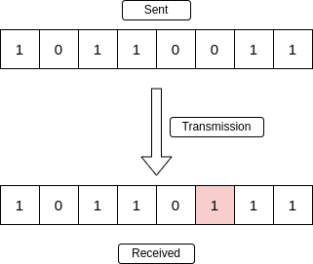
Types of Errors
Single-Bit Error
A single-bit error refers to a type of data transmission error that occurs when one bit (i.e., a single binary digit) of a transmitted data unit is altered during transmission, resulting in an incorrect or corrupted data unit.

Slide 45
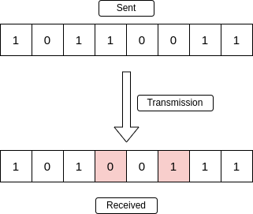
Cont..
Multiple-Bit Error
A multiple-bit error is an error type that arises when more than one bit in a data transmission is affected.
Although multiple-bit errors are relatively rare when compared to single-bit errors, they can still occur, particularly in high-noise or high-interference digital environments.

Slide 46
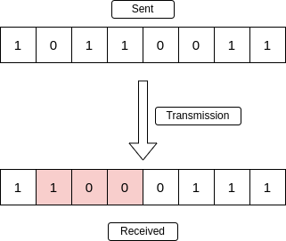
Cont..
Burst Error
When several consecutive bits are flipped mistakenly in digital transmission, it creates a burst error. This error causes a sequence of consecutive incorrect values.

Slide 47
Error Detection Methods
To detect errors, a common technique is to introduce redundancy bits that provide additional information.
In error detection, redundancy refers to adding extra bits to a data stream to help detect if any errors occurred during transmission.
These extra bits, called redundant bits, are generated based on the original data and appended to it before sending.
The receiver then uses these redundant bits to verify the integrity of the received data.

Slide 48
Cont..
Purpose of Redundancy:
The fundamental idea behind error detection is to introduce redundancy, which means including extra information that wasn't originally present in the data.
How it works:
The sender adds these redundant bits to the data using a specific algorithm or encoding scheme. The receiver then uses the same algorithm or scheme to check for inconsistencies between the received data and the redundant bits.

Slide 49
Cont..
Various techniques for error detection include:
Simple Parity Check
Two-Dimensional Parity Check
Checksum
Cyclic Redundancy Check (CRC)

Slide 50
Simple Parity Check
Simple-bit parity is a simple error detection method that involves adding an extra bit to a data transmission. It works as:
1 is added to the block if it contains an odd number of 1’s, and
0 is added if it contains an even number of 1’s
This scheme makes the total number of 1’s even, that is why it is called even parity checking.

Slide 51
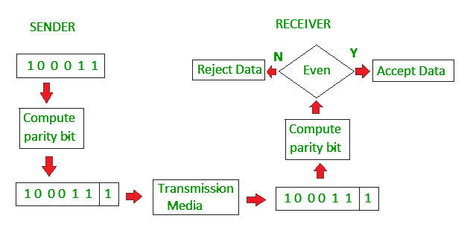

Slide 52
Advantages of Simple Parity Check
Simple parity check can detect all single bit error.
Simple parity check can detect an odd number of errors.
Implementation: Simple Parity Check is easy to implement in both hardware and software.
Minimal Extra Data: Only one additional bit (the parity bit) is added per data unit (e.g., per byte).
Fast Error Detection: The process of calculating and checking the parity bit is quick, which allows for rapid error detection without significant delay in data processing or communication.
Single-Bit Error Detection: It can effectively detect single-bit errors within a data unit, providing a basic level of error detection for relatively low-error environments.

Slide 53
Cont..
Disadvantages of Simple Parity Check
Single Parity check is not able to detect even no. of bit error.
For example, the Data to be transmitted is 101010. Codeword transmitted to the receiver is 1010101 (we have used even parity). Let's assume that during transmission, two of the bits of code word flipped to 1111101. On receiving the code word, the receiver finds the no. of ones to be even and hence no error, which is a wrong assumption.

Slide 54
Two-Dimensional Parity Check
Two-dimensional Parity check bits are calculated for each row, which is equivalent to a simple parity check bit.
Parity check bits are also calculated for all columns, then both are sent along with the data.
At the receiving end, these are compared with the parity bits calculated on the received data.

Slide 55
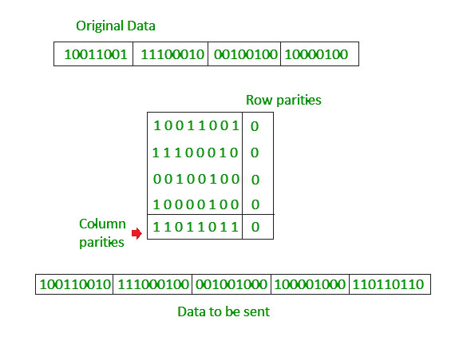

Slide 56
Cont..
Advantages of Two-Dimensional Parity Check
Two-Dimensional Parity Check can detect and correct all single bit error.
Two-Dimensional Parity Check can detect two or three bit error that occur any where in the matrix.
Disadvantages of Two-Dimensional Parity Check
Two-Dimensional Parity Check can not correct two or three bit error. It can only detect two or three bit error.
If we have a error in the parity bit then this scheme will not work.

Slide 57
Checksum
Checksum error detection is a method used to identify errors in transmitted data. The process involves dividing the data into equally sized segments and using a 1's complement to calculate the sum of these segments. The calculated sum is then sent along with the data to the receiver. At the receiver's end, the same process is repeated and if all zeroes are obtained in the sum, it means that the data is correct.

Slide 58
Checksum - Operation at Sender's Side
Firstly, the data is divided into k segments each of m bits.
On the sender’s end, the segments are added using 1’s complement arithmetic to get the sum. The sum is complemented to get the checksum.
The checksum segment is sent along with the data segments.
Checksum - Operation at Receiver's Side
At the receiver’s end, all received segments are added using 1’s complement arithmetic to get the sum. The sum is complemented.
If the result is zero, the received data is accepted; otherwise discarded.

Slide 59
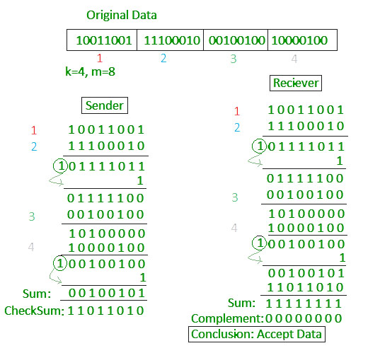

Slide 60
Cyclic Redundancy Check (CRC)
Unlike the checksum scheme, which is based on addition, CRC is based on binary division.
In CRC, a sequence of redundant bits, called cyclic redundancy check bits, are appended to the end of the data unit so that the resulting data unit becomes exactly divisible by a second, predetermined binary number.
At the destination, the incoming data unit is divided by the same number. If at this step there is no remainder, the data unit is assumed to be correct and is therefore accepted.
A remainder indicates that the data unit has been damaged in transit and therefore must be rejected.

Slide 61
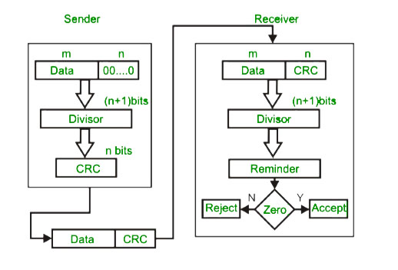

Slide 62
Cont..
CRC Working
We have given dataword of length n and divisor of length k.
Step 1: Append (k-1) zero's to the original message
Step 2: Perform modulo 2 division
Step 3: Remainder of division = CRC
Step 4: Code word = Data with append k-1 zero's + CRC
Note:
CRC must be k-1 bits
Length of Code word = n+k-1 bits

Slide 63
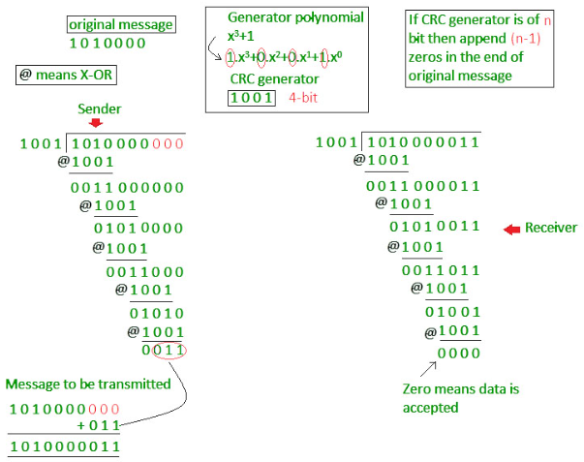

Slide 64
Hamming Code
Hamming code is an error-correcting code used to ensure data accuracy during transmission or storage.
Hamming code detects and corrects the errors that can occur when the data is moved or stored from the sender to the receiver.
This simple and effective method helps improve the reliability of communication systems and digital storage.
It adds extra bits to the original data, allowing the system to detect and correct single-bit errors.
It is a technique developed by Richard Hamming in the 1950s.

Slide 65
Types of Parity Bits
A parity bit is a bit appended to a data of binary bits to ensure that the total number of 1’s in the data is even or odd. Parity bits are used for error detection. There are two types of parity bits:
Even Parity Bit: In the case of even parity, for a given set of bits, the number of 1’s are counted. If that count is odd, the parity bit value is set to 1, making the total count of occurrences of 1’s an even number. If the total number of 1’s in a given set of bits is already even, the parity bit's value is 0.
Odd Parity Bit: In the case of odd parity, for a given set of bits, the number of 1’s are counted. If that count is even, the parity bit value is set to 1, making the total count of occurrences of 1’s an odd number. If the total number of 1’s in a given set of bits is already odd, the parity bit's value is 0.

Slide 66
Algorithm of Hamming Code
Hamming Code is simply the use of extra parity bits to allow the identification of an error.
Step 1: Write the bit positions starting from 1 in binary form (1, 10, 11, 100, etc).
Step 2: All the bit positions that are a power of 2 are marked as parity bits (1, 2, 4, 8, etc).
Step 3: All the other bit positions are marked as data bits.

Slide 67
Cont..
Step 4: Each data bit is included in a unique set of parity bits, as determined its bit position in binary form:
Parity bit 1 covers all the bits positions whose binary representation includes a 1 in the least significant position (1, 3, 5, 7, 9, 11, etc).
Parity bit 2 covers all the bits positions whose binary representation includes a 1 in the second position from the least significant bit (2, 3, 6, 7, 10, 11, etc).
Parity bit 4 covers all the bits positions whose binary representation includes a 1 in the third position from the least significant bit (4–7, 12–15, 20–23, etc).
Parity bit 8 covers all the bits positions whose binary representation includes a 1 in the fourth position from the least significant bit bits (8–15, 24–31, 40–47, etc).
In general, each parity bit covers all bits where the bitwise AND of the parity position and the bit position is non-zero.

Slide 68
Step 5: Since we check for even parity set a parity bit to 1 if the total number of ones in the positions it checks is odd. Set a parity bit to 0 if the total number of ones in the positions it checks is even.

Slide 69
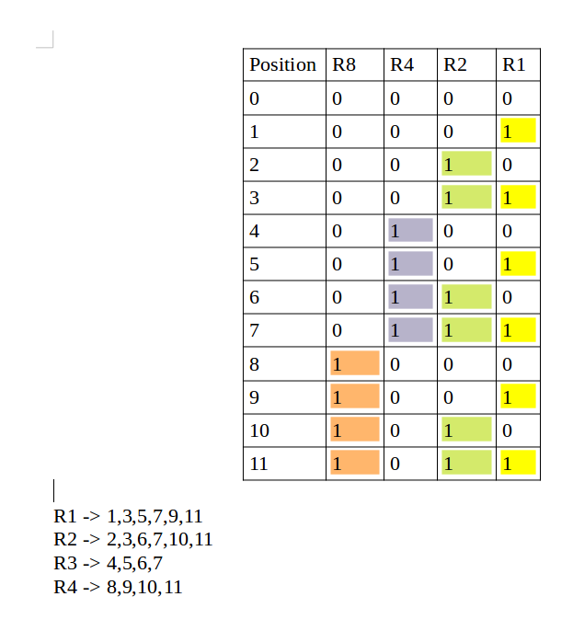

Slide 70
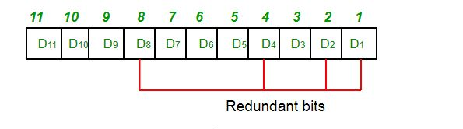
Determining The Position of Redundant Bits
A redundancy bits are placed at positions that correspond to the power of 2. As in the above example:
The number of data bits = 7
The number of redundant bits = 4
The total number of bits = 7+4=11
The redundant bits are placed at positions corresponding to power of 2 that is 1, 2, 4, and 8

Slide 71
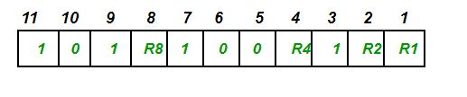
Suppose the data to be transmitted is 1011001 from sender to receiver, the bits will be placed as follows:

Slide 72
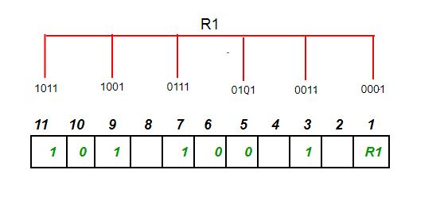
Determining The Parity Bits According to Even Parity
R1 bit is calculated using parity check at all the bits positions whose binary representation includes a 1 in the least significant position. R1: bits 1, 3, 5, 7, 9, 11

Slide 73
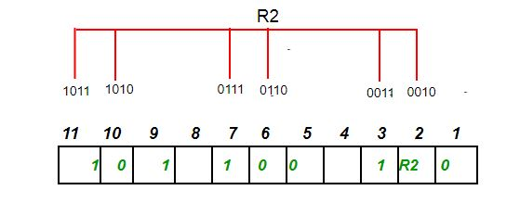
To find the redundant bit R1, we check for even parity. Since the total number of 1’s in all the bit positions corresponding to R1 is an even number. So, the value of R1 (parity bit’s value) = 0.
R2 bit is calculated using parity check at all the bits positions whose binary representation includes a 1 in the second position from the least significant bit. R2: bits 2,3,6,7,10,11

Slide 74
To find the redundant bit R2, we check for even parity. Since the total number of 1’s in all the bit positions corresponding to R2 is odd the value of R2(parity bit’s value)=1
R4 bit is calculated using parity check at all the bits positions whose binary representation includes a 1 in the third position from the least significant bit. R4: bits 4, 5, 6, 7

Slide 75
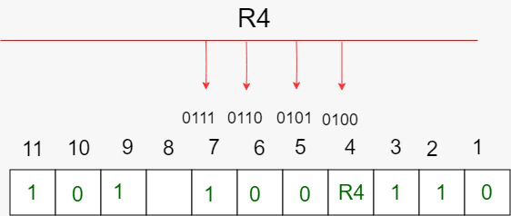

Slide 76
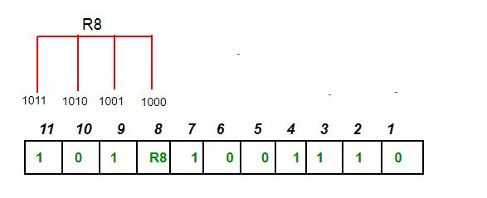
To find the redundant bit R4, we check for even parity. Since the total number of 1’s in all the bit positions corresponding to R4 is odd so the value of R4(parity bit’s value) = 1
R8 bit is calculated using parity check at all the bits positions whose binary representation includes a 1 in the fourth position from the least significant bit. R8: bit 8,9,10,11

Slide 77
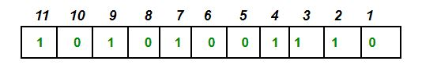
To find the redundant bit R8, we check for even parity. Since the total number of 1’s in all the bit positions corresponding to R8 is an even number the value of R8(parity bit’s value)=0. Thus, the data transferred is:

Slide 78
Error Detection and Correction
Suppose in the above example the 6th bit is changed from 0 to 1 during data transmission, then it gives new parity values in the binary number:

Slide 79
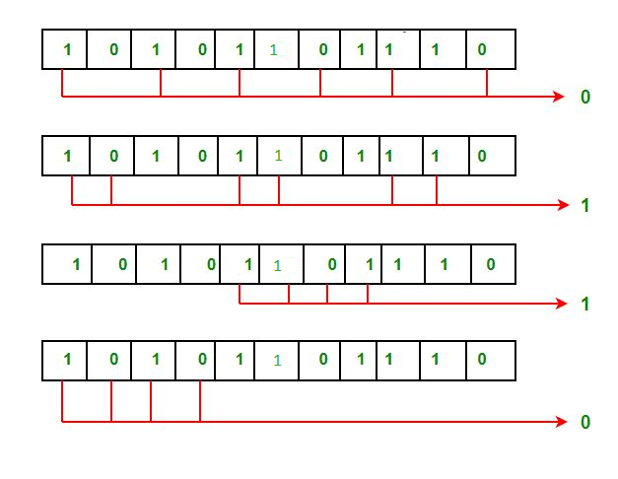

Slide 80
Cont..
For all the parity bits we will check the number of 1's in their respective bit positions.
For R1: bits 1, 3, 5, 7, 9, 11. We can see that the number of 1's in these bit positions are 4 and that's even so we get a 0 for this.
For R2: bits 2,3,6,7,10,11 . We can see that the number of 1's in these bit positions are 5 and that's odd so we get a 1 for this.
For R4: bits 4, 5, 6, 7 . We can see that the number of 1's in these bit positions are 3 and that's odd so we get a 1 for this.
For R8: bit 8,9,10,11 . We can see that the number of 1's in these bit positions are 2 and that's even so we get a 0 for this.
The bits give the binary number 0110 whose decimal representation is 6. Thus, bit 6 contains an error. To correct the error the 6th bit is changed from 1 to 0.

Slide 81
Features of Hamming Code
Error Detection and Correction: Hamming code is designed to detect and correct single-bit errors that may occur during the transmission of data. This ensures that the recipient receives the same data that was transmitted by the sender.
Redundancy: Hamming code uses redundant bits to add additional information to the data being transmitted. This redundancy allows the recipient to detect and correct errors that may have occurred during transmission.
Efficiency: Hamming code is a relatively simple and efficient error-correction technique that does not require a lot of computational resources. This makes it ideal for use in low-power and low-bandwidth communication networks.
Widely Used: Hamming code is a widely used error-correction technique and is used in a variety of applications, including telecommunications, computer networks, and data storage systems.

Slide 82
Single Error Correction: Hamming code is capable of correcting a single-bit error, which makes it ideal for use in applications where errors are likely to occur due to external factors such as electromagnetic interference.
Limited Multiple Error Correction: Hamming code can only correct a limited number of multiple errors. In applications where multiple errors are likely to occur, more advanced error-correction techniques may be required.

Slide 83
Advantages of Hamming Code
Hamming code can detect and correct single-bit errors, enhancing data reliability during transmission and storage.
It adds a minimal number of redundant bits to the original data, maintaining a good balance between data integrity and overhead. The algorithm for generating and checking Hamming code is straightforward and can be easily implemented in both hardware and software.
By detecting and correcting errors, Hamming code ensures that the received data is accurate, reducing the chances of data corruption.
Hamming code is widely used in various fields such as computer memory (RAM), data storage devices, and communication systems.
Compared to more complex error correction codes, Hamming code provides a cost-effective solution for applications where single-bit error correction is sufficient.

Slide 84
Disadvantages of Hamming Code
Hamming code can only correct single-bit errors. It is unable to correct multiple-bit errors, which limits its effectiveness in environments with high error rates.
While it can detect single-bit and some two-bit errors, Hamming code cannot detect all multiple-bit errors. This reduces its reliability in certain applications.
Although it uses fewer redundant bits compared to some other error correction methods, the addition of these bits still increases the overall data size, which can be a drawback in bandwidth-constrained environments.
Implementing Hamming code requires additional hardware or software resources for error detection and correction, which can be a limitation in resource-constrained systems.

Slide 85
Advantages of Error Detection
Increased Data Reliability: Error detection ensures that the data transmitted over the network is reliable, accurate, and free from errors. This ensures that the recipient receives the same data that was transmitted by the sender.
Improved Network Performance: Error detection mechanisms can help to identify and isolate network issues that are causing errors. This can help to improve the overall performance of the network and reduce downtime.
Enhanced Data Security: Error detection can also help to ensure that the data transmitted over the network is secure and has not been tampered with.

Slide 86
Disadvantages of Error Detection
Overhead: Error detection requires additional resources and processing power, which can lead to increased overhead on the network. This can result in slower network performance and increased latency.
False Positives: Error detection mechanisms can sometimes generate false positives, which can result in unnecessary retransmission of data. This can further increase the overhead on the network.
Limited Error Correction: Error detection can only identify errors but cannot correct them. This means that the recipient must rely on the sender to retransmit the data, which can lead to further delays and increased network overhead.

Slide 87
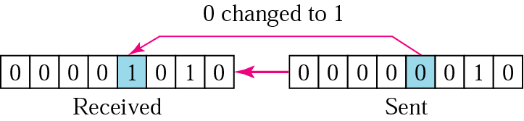
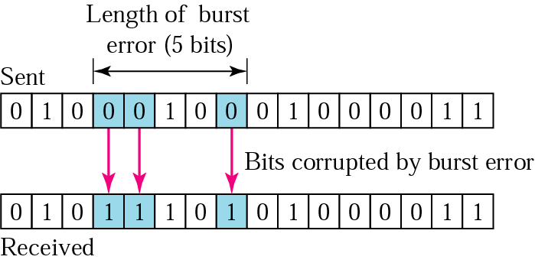
Types of Error
Single-Bit Error: In a single-bit error, only one bit in the data unit has changed.
Burst Error: A burst error means that 2 or more bits in the data unit have changed.

Slide 89
Error Detection and Correction
Data can be corrupted during transmission. For reliable communication, errors must be detected and corrected.
Two basic strategies to deal with errors:
1.Error correcting codes.
Include enough redundant information to enable the receiver to correct errors.
2. Error detecting codes.
Include only enough redundancy to detect an error has occurred (but not which error).
Error codes are examined in Link Layer because this is the first place that we have run up against the problem of reliability transmitting groups of bits.
– Codes are reused because reliability is an overall concern.
– The error correcting code are also seen in the physical layer for noise channels.
– Commonly they are used in link, network and transport layer.

Slide 90
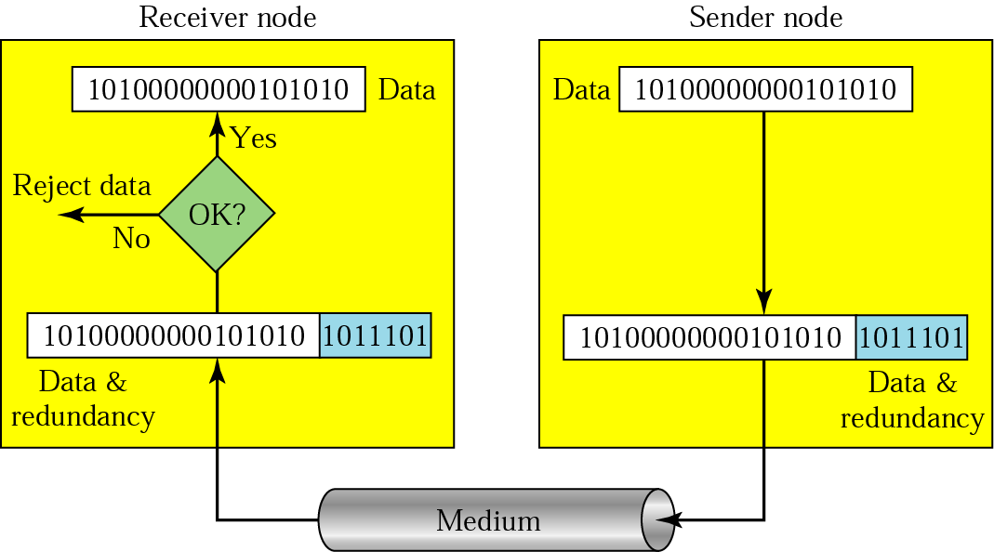
Error Detection
Redundancy
Parity Check
Cyclic Redundancy Check (CRC)
Checksum
Redundancy: Error detection uses the concept of redundancy, which means adding extra bits for detecting errors at the destination.

Slide 91
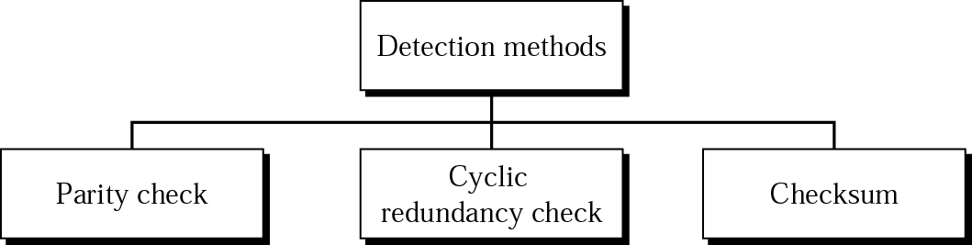

Slide 92
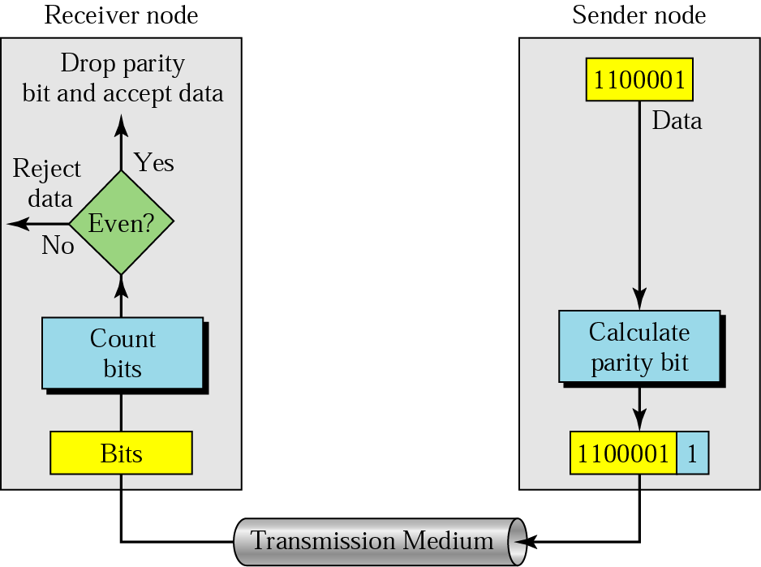
Parity Check
Even-parity concept dig.:
In parity check, a parity bit is added to every data unit so that the total number of 1s is even
(or odd for odd-parity).

Slide 93
Example: Suppose the sender wants to send the word world. In ASCII the five characters are coded as
1110111 1101111 1110010 1101100 1100100
The following shows the actual bits sent :
11101110 11011110 11100100 11011000 11001001
Scenario 1: Now suppose the word world in Example 1 is received by the receiver without being corrupted in transmission.
11101110 11011110 11100100 11011000 11001001
The receiver counts the 1s in each character and comes up with even numbers (6, 6, 4, 4, 4). The data are accepted.
Scenario 2: Now suppose the word world in Example 1 is corrupted during transmission.
11111110 11011110 11101100 11011000 11001001
The receiver counts the 1s in each character and comes up with even and odd numbers (7, 6, 5, 4, 4). The receiver knows that the data are corrupted, discards them, and asks for retransmission.

Slide 94
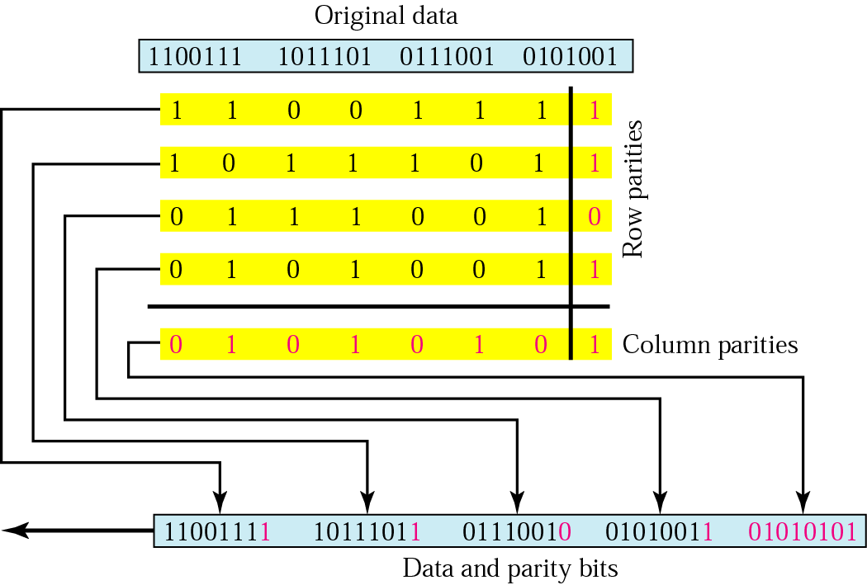
Simple parity check can detect all single-bit errors. It can detect burst errors only if the total number of errors in each data unit is odd.
Two-dimensional parity: Parity check bits are calculated for each row, which is equivalent to a simple parity check bit. Parity check bits are also calculated for all columns, then both are sent along with the data. At the receiving end these are compared with the parity bits calculated on the received data.

Slide 95
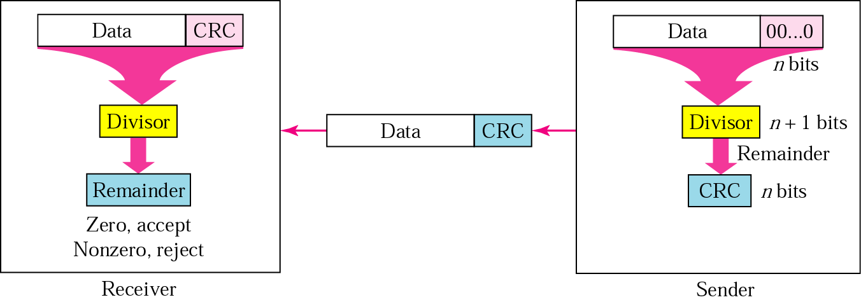
Cyclic Redundancy Checks (CRC)
The Cyclic Redundancy Checks (CRC) is the most powerful method for Error-Detection and Correction.
CRC generator and checker diagram:

Slide 96
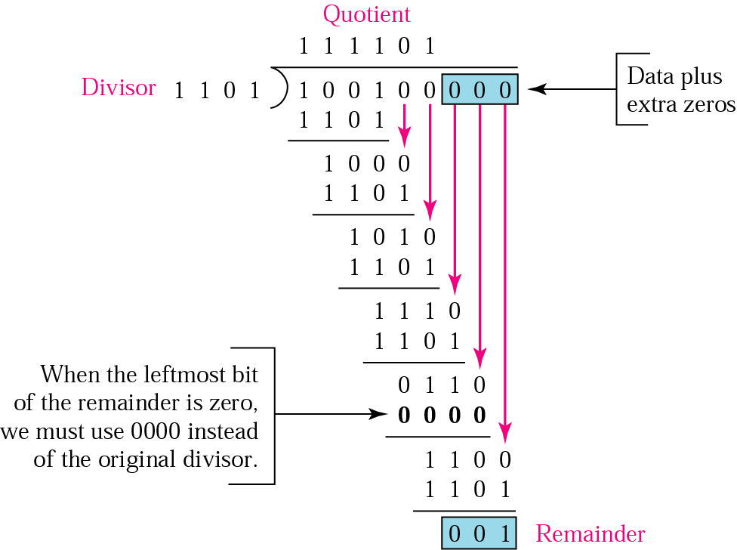
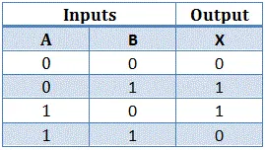
Binary division in a CRC generator (at sender side):
Perform XOR operation
XoR Operation

Slide 97
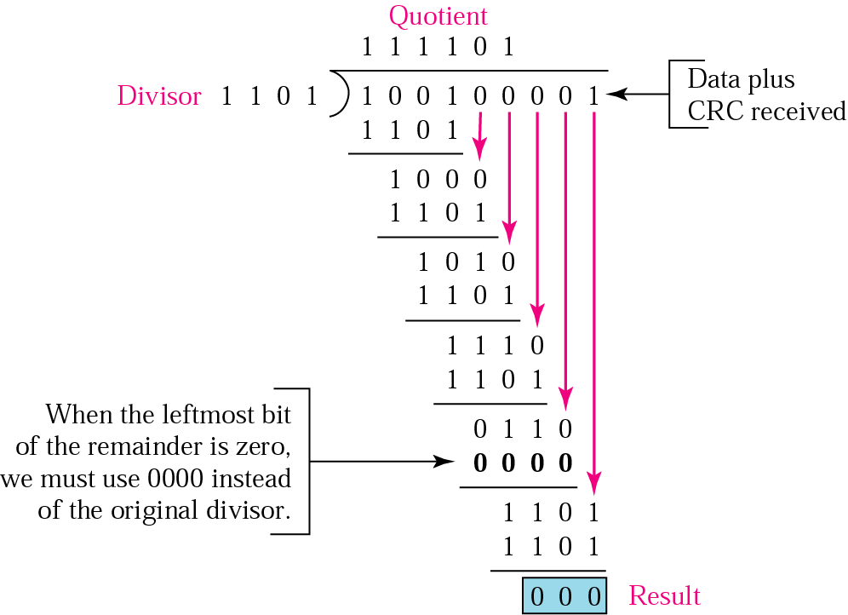
Binary division in a CRC checker (at receiver side):

Slide 98
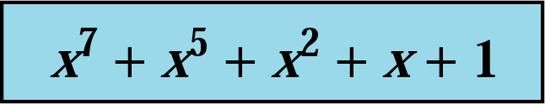
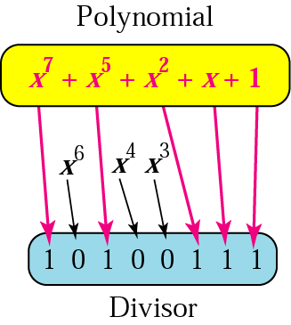
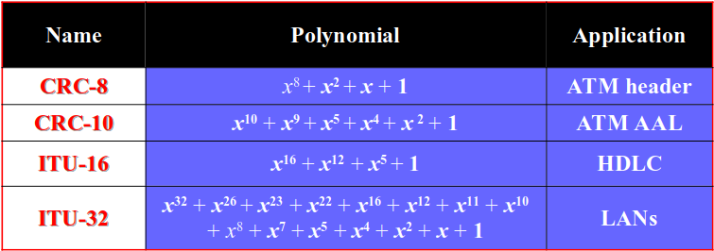
A polynomial: Sometimes divisor is given in polynomial form.
A polynomial representing a divisor
Standard polynomials :

Slide 99
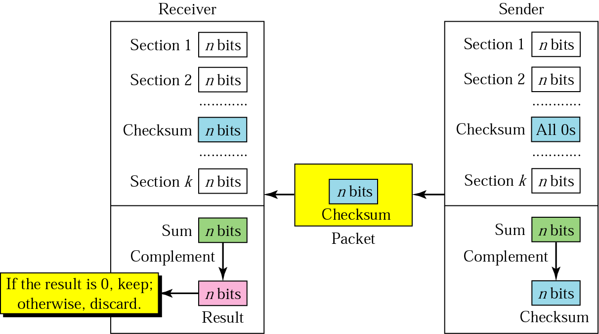
Checksum
In checksum error detection scheme, the data is divided into k segments each of m bits.

Slide 100
Checksum
The sender follows these steps:
The unit is divided into k sections, each of n bits.
All sections are added using one’s complement to get the sum.
The sum is complemented and becomes the checksum.
The checksum is sent with the data.
The receiver follows these steps:
The unit is divided into k sections, each of n bits.
All sections are added using one’s complement to get the sum.
The sum is complemented.
If the result is zero, the data are accepted: otherwise, rejected.

Slide 101
Checksum
Example: Suppose the following block of 16 bits is to be sent using a checksum of 8 bits.
At sender side:
10101001 00111001
The numbers are added using one’s complement
10101001
00111001
------------
Sum 11100010
Checksum 00011101
The pattern sent is 10101001 00111001 00011101

Slide 102
Checksum
At receiver side: Now suppose the receiver receives the pattern sent in Example 7 and there is no error.
10101001 00111001 00011101
When the receiver adds the three sections, it will get all 1s, which, after complementing, is all 0s and shows that there is no error.
10101001
00111001
00011101
Sum 11111111
Complement 00000000 means that the pattern is OK.
The main problem is that the error goes undetected if one or more bits of a subunit is damaged and the corresponding bit or bits of opposite value in second subunit are also damaged. This is because the sum of those columns remains unchanged.

Slide 103
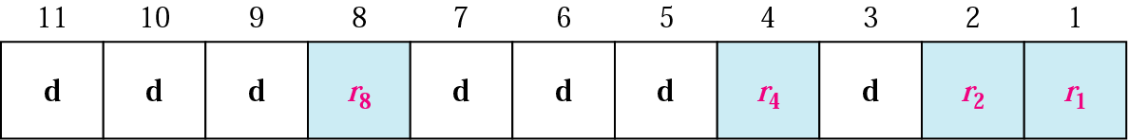
Hamming Code
Hamming code is an error correction system that can detect and correct errors when data is stored or transmitted. It requires adding additional parity bits with the data.
Redundant Bits:
Redundant bits are extra binary bits that are generated and added to the information-carrying bits of data transfer to ensure that no bits were lost during the data transfer. The redundancy bits are placed at certain calculated positions to eliminate the errors and the distance between the two redundancy bits is called "Hamming Distance"
The position of redundant bit is calculated as 2^{n} where n= 0,1,2,3,....,n

Slide 104
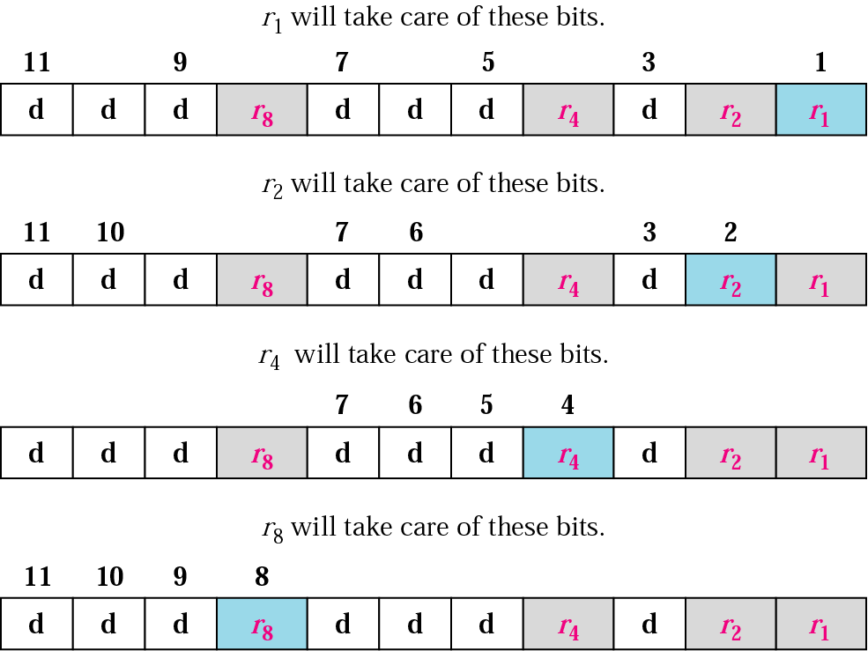
Redundancy bits calculation

Slide 105
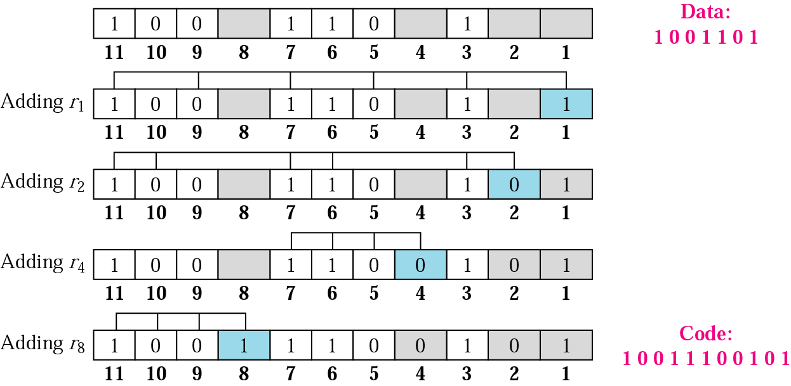
Example of redundancy bit calculation:

Slide 106
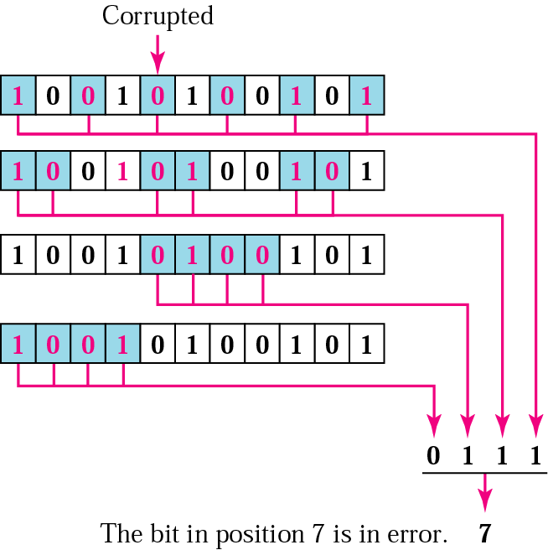
Error detection using Hamming code:

Slide 108
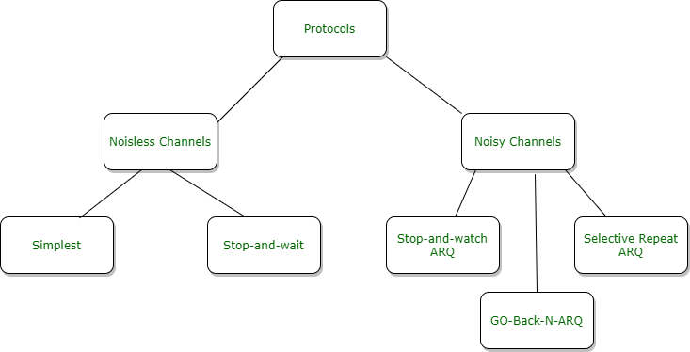
Flow Control Protocols:
A protocol is a set of rules used by two devices to communicate.
Flow Control is technique that generally observes proper flow of data from sender to receiver.
It is very essential because it is possible for sender to transmit data or information at very fast rate and hence receiver can receive this information and process it. This can happen only if receiver has very high load of traffic as compared to sender, or if receiver has power of processing less as compared to sender.
Flow control is basically technique that gives permission to two of stations that are working and processing at different speeds to just communicate with one another.
Flow control is actually set of procedures that explains sender about how much data or frames it can transfer or transmit before data overwhelms receiver.
Categorization of protocol :

Slide 109
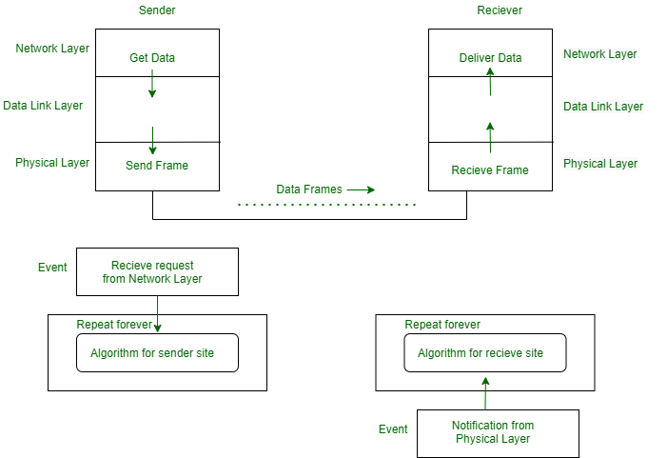
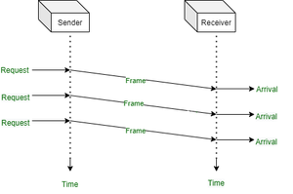
Noiseless Channel : An idealistic channel in which no frames are lost, corrupted or duplicated. The protocol does not implement error control in this category. There are two protocols for the noiseless channel.
1. Simplest Protocol –Receiver can maintain any frame received with insignificant processing time. The receiver’s data link layer immediately removes the header from the frame and assigns the data packet to its network layer, which can also accept the packet immediately. That is to say, the receiver can never be overwhelmed with forthcoming frames.
Design :
Flow Diagram :

Slide 110


2. Stop-and-wait protocol- It is straightforward protocol. The sender sends a frame and waits for a response from the receiver. When ACK(acknowledged) will arrival from the receiver side then send the next frame and so on.
Design :
Flow Diagram :

Slide 111
Noisy Channel: Although the Stop-and-Wait Protocol gives us an idea of how to add flow control to its predecessor, noiseless channels are nonexistent. We can ignore the error (as we sometimes do), or we need to add error control to our protocols. We discuss three protocols in this section that use error control.
1.The Stop-and-Wait Automatic Repeat Request (Stop-and-Wait ARQ): The Stop-and-Wait Automatic Repeat Request (Stop-and-Wait ARQ), adds a simple error control mechanism to the Stop-and-Wait Protocol.
To detect and correct corrupted frames, we need to add redundancy bits to our data frame.
When the frame arrives at the receiver site, it is checked and if it is corrupted, it is silently discarded.
The detection of errors in this protocol is manifested by the silence of the receiver.
The protocol specifies that frames need to be numbered. This is done by using sequence numbers. A field is added to the data frame to hold the sequence number of that frame. For example, if we decide that the field is m bits long, the sequence numbers start from 0, go to 2^{m} - 1, and then are repeated.
The acknowledgment numbers always announce the sequence number of the next frame expected by the receiver. For example, if frame 0 has arrived safe and sound, the receiver sends an ACK frame with acknowledgment 1 (meaning frame 1 is expected next). If frame 1 has arrived safe and sound, the receiver sends an ACK frame with acknowledgment 0 (meaning frame 0 is expected).

Slide 112


The Stop-and-Wait Automatic Repeat Request (Stop-and-Wait ARQ): In Stop-and-WaitARQ~ the acknowledgment number always announces in modulo-2 arithmetic the sequence number of the next frame expected.
Normal operation Stop-and-Wait ARQ, lost frame

Slide 113


The Stop-and-Wait Automatic Repeat Request (Stop-and-Wait ARQ):
lost ACK frame : Stop-and-Wait ARQ, delayed ACK

Slide 114

Sliding Window Protocol:
Go-Back-N ARQ and Selective-Repeat ARQ are the sliding window protocol.
Sliding Window Protocol sends multiple frames at a time.
Number of frames to be sent is depend on the window size
Each frame have frame no. called sequence no.

Slide 115



Slide 116


Slide 117
2. Go-Back-N Automatic Repeat Request:
In this protocol we can send several frames before receiving acknowledgments; we keep a copy of these frames until the acknowledgments arrive.
Sequence Numbers: Frames from a sending station are numbered sequentially. If the header of the frame allows m bits for the sequence number, the sequence numbers range from 0 to 2^{m}- 1. For example, if m is 4, the only sequence numbers are 0 through 15 inclusive.
In the Go-Back-N Protocol, the sequence numbers are modulo 2^{m} where m is the size of the sequence number field in bits.
size of the window: The maximum size of the window is 2^{m}- 1
The window itself is an abstraction; three variables define its size and location at any time. We call these variables Sf(send window, the first outstanding frame), Sn (send window, the next frame to be sent), and S size (send window, size). The variable Sf defines the sequence number of the first (oldest) outstanding frame. The variable Sn holds the sequence number that will be assigned to the next frame to be sent. Finally, the variable Ssize defines the size of the window.
Timers, Acknowledgment
Resending a Frame: When the timer expires, the sender resends all outstanding frames. For example, suppose the sender has already sent frame 6, but the timer for frame 3 expires. This means that frame 3 has not been acknowledged; the sender goes back and sends frames 3, 4,5, and 6 again. That is why the protocol is called Go-Back-N ARQ.

Slide 118


Go-Back-N ARQ: lost frame
Go-Back-N ARQ: normal operation

Slide 119
Window size for Go-Back-N ARQ
We can now show why the size of the send window must be less than 2^{m}. As an example, we choose m = 2, which means the size of the window can be 2^{m}-1, or 3. Figure in next slide compares a window size of 3 against a window size of 4. If the size of the window is 3 (less than 2 2) and all three acknowledgments are lost, the frame timer expires and all three frames are resent. The receiver is now expecting frame 3, not frame 0, so the duplicate frame is correctly discarded. On the other hand, if the size of the window is 4 (equal to 2 raised 2 ) and all acknowledgments are lost, the sender will send a duplicate of frame 0. However, this time the window of the receiver expects to receive frame 0, so it accepts frame 0, not as a duplicate, but as the first frame in the next cycle. This is an error.

Slide 120

Window size for Go-Back-N ARQ

Slide 121
Selective Repeat Automatic Repeat Request
For noisy links, there is another mechanism that does not resend N frames when just one frame is damaged; only the damaged frame is resent. This mechanism is called Selective RepeatARQ.
It is more efficient for noisy links, but the processing at the receiver is more complex.
Windows : The Selective Repeat Protocol also uses two windows: a send window and a receive window. However, there are differences between the windows in this protocol and the ones in Go-Back-N. First, the size of the send window is much smaller; it is 2^{m}-1. Second, the receive window is the same size as the send window.
For example, if m = 4, the sequence numbers go from 0 to 15, but the size of the window is just 8 (it is 15 in the Go-Back-N Protocol).

Slide 122

Selective Repeat ARQ: lost frame

Slide 123
Selective Repeat ARQ: window size
We can now show why the size of the sender and receiver windows must be at most one-half of 2^{m}. For an example, we choose m = 2, which means the size of the window is 2^{m}/2, or 2. Figure 11.21 compares a window size of 2 with a window size of 3. If the size of the window is 2 and all acknowledgments are lost, the timer for frame 0 expires and frame 0 is resent. However, the window of the receiver is now expecting frame 2, not frame 0, so this duplicate frame is correctly discarded. When the size of the window is 3 and all acknowledgments are lost, the sender sends a duplicate of frame 0. However, this time, the window of the receiver expects to receive frame 0 (0 is part of the window), so it accepts frame 0, not as a duplicate, but as the first frame in the next cycle. This is clearly an error.

Slide 124

Selective Repeat ARQ: window size

Slide 125
Piggybacking
In real life, data frames are normally flowing in both directions: from node A to node B and from node B to node A.
This means that the control information also needs to flow in both directions.
A technique called piggybacking is used to improve the efficiency of the bidirectional protocols.
When a frame is carrying data from A to B, it can also carry control information about arrived (or lost) frames from B; when a frame is carrying data from B to A, it can also carry control information about the arrived (or lost) frames from A.

Slide 126
WAN Connectivity:
PPP: one of the most common protocols for point-to-point access is the Point-to-Point Protocol (PPP) .It is byte-oriented protocol.
HDLC: High-level Data Link Control (HDLC) is a bit-oriented protocol for communication over point-to-point and multipoint links.

Slide 127
Point-to-Point Protocol (PPP)
Today, millions of Internet users who need to connect their home computers to the server of an Internet service provider use PPP. The majority of these users have a traditional modem; they are connected to the Internet through a telephone line, which provides the services of the physical layer. But to control and manage the transfer of data, there is a need for a point-to-point protocol at the data link layer. PPP is by far the most common.

Slide 128
Point-to-Point Protocol (PPP)
PPP provides several services:
1. PPP defines the format of the frame to be exchanged between devices.
2. PPP defines how two devices can negotiate the establishment of the link and the exchange of data.
3. PPP defines how network layer data are encapsulated in the data link frame.
4. PPP defines how two devices can authenticate each other.
5. PPP provides multiple network layer services supporting a variety of network layer protocols.
6. PPP provides connections over multiple links.
7. PPP provides network address configuration. This is particularly useful when a home user needs a temporary network address to connect to the Internet.
On the other hand, to keep PPP simple, several services are missing:
1. PPP does not provide flow control. 2. PPP has a very simple mechanism for error control. 3.PPP does not provide a sophisticated addressing mechanism to handle frames in a multipoint configuration.

Slide 129

Frame Format of PPP:
PPP is a byte-oriented protocol. Framing is done according to the byte-oriented protocols
Flag: A PPP frame starts and ends with a I-byte flag with the bit pattern 01111110. The flag is treated as a byte.
Address: The address field in this protocol is a constant value and set to 11111111 (broadcast address). During negotiation (discussed later), the two parties may agree to omit this byte.
Control: This field is set to the constant value 11000000. The two parties can agree, during negotiation, to omit this byte.
Protocol: The protocol field defines what is being carried in the data field: either user data or other information.
Payload field: This field carries either the user data or other information.
FCS: The frame check sequence (FCS) is simply a 2-byte or 4-byte standard CRe

Slide 130
2. High-level Data Link Control (HDLC)
High-level Data Link Control (HDLC) is a bit-oriented protocol for communication over point-to-point and multipoint links. It implements the ARQ mechanisms.
HDLC provides two common transfer modes that can be used in different configurations: normal response mode (NRM) and asynchronous balanced mode (ABM).
Normal Response Mode: In normal response mode (NRM), the station configuration is unbalanced. We have one primary station and multiple secondary stations. A primary station can send commands; a secondary station can only respond. The NRM is used for both point-to-point and multiple-point links.
Asynchronous Balanced Mode: In asynchronous balanced mode (ABM), the configuration is balanced. The link is point-to-point, and each station can function as a primary and a secondary (acting as peers).

Slide 131


2. High-level Data Link Control (HDLC)
Normal Response Mode:
Asynchronous Balanced Mode:

Slide 132

2. High-level Data Link Control (HDLC)
Framing: HDLC defines three types of frames: information frames (I-frames), supervisory frames (S-frames), and unnumbered frames (V-frames). Each type of frame serves as an envelope for the transmission of a different type of message. I-frames are used to transport user data and control information relating to user data (piggybacking). S-frames are used only to transport control information. V-frames are reserved for system management.

Slide 133
Flag: The flag field of an HDLC frame is an 8-bit sequence with the bit pattern 01111110 that identifies both the beginning and the end of a frame and serves as a synchronization pattern for the receiver.
Address: The second field of an HDLC frame contains the address of the secondary station. If a primary station created the frame, it contains a to address. If a secondary creates the frame, it contains a from address.
Control: The control field is a 1- or 2-byte segment of the frame used for flow and error control.
Information field: The information field contains the user's data from the network layer or management information.
FCS: The frame check sequence (FCS) is the HDLC error detection field. It can contain either a 2- or 4-byte ITU-T CRC.

Slide 134

MAC Sub layer: Multiple Access Protocols:
In Data Link Layer the upper sublayer that is responsible for flow and error control is called the logical link control (LLC) layer; the lower sublayer that is mostly responsible for multiple-access resolution is called the media access control (MAC) layer.

Slide 135

Random Access Protocol
In random access or contention methods, no station is superior to another station and none is assigned the control over another. Two features give this method its name. First, there is no scheduled time for a station to transmit. Transmission is random among the stations. That is why these methods are called random access. Second, no rules specify which station should send next. Stations compete with one another to access the medium. That is why these methods are also called contention methods.
ALOHA: ALOHA, the earliest random access method, was developed at the University of Hawaii in early 1970. It was designed for a radio (wireless) LAN, but it can be used on any shared medium. When a station sends data, another station may attempt to do so at the same time.The data from the two stations collide and become garbled.

Slide 136

Pure ALOHA
The original ALOHA protocol is called pure ALOHA. The idea is that each station sends a frame whenever it has a frame to send.
However, since there is only one channel to share, there is the possibility of collision between frames from different stations

Slide 137
Pure ALOHA
We need to mention that even if one bit of a frame coexists on the channel with one bit from another frame, there is a collision and both will be destroyed.
we need to resend the frames that have been destroyed during transmission.
The pure ALOHA protocol relies on acknowledgments from the receiver.
When a station sends a frame, it expects the receiver to send an acknowledgment.
If the acknowledgment does not arrive after a time-out period, the station assumes that the frame (or the acknowledgment) has been destroyed and resends the frame.
Pure ALOHA dictates that
when the time-out period passes, each station waits a random amount of time before resending its frame.
The randomness will help avoid more collisions. We call this time the back-off time T_{B}.
Pure ALOHA has a second method to prevent congesting the channel with retransmitted frames.
After a maximum number of retransmission attempts Kmax' a station must give up and try later.

Slide 138

Procedure for pure ALOHA protocol
Let us call G the average number of frames generated by the system
during one frame transmission time.
The throughput for pure ALOHA is
S =G x e-2G.
The maximum throughput
Smax =0.184 when G =(1/2).

Slide 139

Slotted ALOHA
Slotted ALOHA was invented to improve the efficiency of pure ALOHA.
In slotted ALOHA we divide the time into slots of T_{fr} s and force the station to send only at the beginning of the time slot.
Frames in a slotted ALOHA network as shown in Figure

Slide 140
Because a station is allowed to send only at the beginning of the synchronized time slot, if a station misses this moment, it must wait until the beginning of the next time slot.
Of course, there is still the possibility of collision if two stations try to send at the beginning of the same time slot.
Slotted ALOHA vulnerable time = T_{fr}
The average number of successful transmissions for slotted ALOHA is S = G x e- G . The maximum throughput Smax is 0.368, when G = 1.
Carrier Sense Multiple Access (CSMA):
The chance of collision can be reduced if a station senses the medium before trying to use it.
Carrier sense multiple access (CSMA) requires that each station first listen to the medium (or check the state of the medium) before sending.
In other words, CSMA is based on the principle "sense before transmit" or "listen before talk."
CSMA can reduce the possibility of collision, but it cannot eliminate it.Stations are connected to a shared channel (usually a dedicated medium).
The possibility of collision still exists because of propagation delay; when a station sends a frame, it still takes time (although very short) for the first bit to reach every station and for every station to sense it. In other words, a station may sense the medium and find it idle, only because the first bit sent by another station has not yet been received.
The vulnerable time for CSMA is the propagation time T _{P} . This is the time needed for a signal to propagate from one end of the medium to the other.

Slide 141

Collision in CSMA

Slide 142
What should a station do if the channel is busy? What should a station do if the channel is idle? Three methods have been devised to answer these questions: the I-persistent method, the nonpersistent method, and the p-persistent method.
1. I-Persistent: The I-persistent method is simple and straightforward. In this method, after the station finds the line idle, it sends its frame immediately (with probability I).
This method has the highest chance of collision because two or more stations may find the line idle and send their frames immediately
2. Nonpersistent: In the nonpersistent method, a station that has a frame to send senses the line. If the line is idle, it sends immediately. If the line is not idle, it waits a random amount of time and then senses the line again. The nonpersistent approach reduces the chance of collision but reduces the efficiency of the network

Slide 143
3. p-Persistent: The p-persistent method is used if the channel has time slots with a slot duration equal to or greater than the maximum propagation time. The p-persistent approach combines the advantages of the other two strategies. It reduces the chance of collision and improves efficiency. In this method, after the station finds the line idle it follows these steps:
1. With probability p, the station sends its frame.
2. With probability q = 1 - p, the station waits for the beginning of the next time slot and checks the line again.
a. If the line is idle, it goes to step 1.
b. If the line is busy, it acts as though a collision has occurred and uses the back- off procedure.

Slide 144

Flow diagram for three persistence methods:

Slide 145
Carrier Sense Multiple Access with Collision Detection (CSMA/CD):
Carrier sense multiple access with collision detection (CSMA/CD) augments(extend) the algorithm to handle the collision.
In this method, a station monitors the medium after it sends a frame to see if the transmission was successful. If so, the station is finished.
In CSMA/CD, transmission and collision detection is a continuous process.
We do not send the entire frame and then look for a collision.
The station transmits and receives continuously and simultaneously (using two different ports).
We use a loop to show that transmission is a continuous process.
We constantly monitor in order to detect one of two conditions: either transmission is finished or a collision is detected.
Either event stops transmission. When we come out of the loop, if a collision has not been detected, it means that transmission is complete; the entire frame is transmitted. Otherwise, a collision has occurred.
The throughput of CSMA/CD is greater than that of pure or slotted ALOHA. The maximum throughput occurs at a different value of G and is based on the persistence method and the value of p in the p-persistent approach. For I-persistent method the maximum throughput is around 50 percent when G = 1. For nonpersistent method, the maximum throughput can go up to 90 percent when G is between 3 and 8

Slide 146


Slide 147
Carrier Sense Multiple Access with Collision Avoidance (CSMA/CA)
CSMA/CA was mostly intended for use in wireless networks. Collisions are avoided through the use of CSMA/CA's three strategies: the interframe space, the contention window, and acknowledgments
Interframe Space (IFS):
First, collisions are avoided by deferring transmission even if the channel is found idle.
When an idle channel is found, the station does not send immediately. It waits for a period of time called the interframe space or IFS
In CSMA/CA, the IFS can also be used to define the priority of a station or a frame. For example, a station that is assigned a shorter IFS has a higher priority.
Contention Window:
The contention window is an amount of time divided into slots. A station that is ready to send chooses a random number of slots as its wait time.
The contention window is that the station needs to sense the channel after each time slot.
In CSMA/CA, if the station finds the channel busy, it does not restart the timer of the contention window; it stops the timer and restarts it when the channel becomes idle.

Slide 148

Carrier Sense Multiple Access with Collision Detection (CSMA/CA):
Acknowledgment: The positive acknowledgment and the time-out timer can help guarantee that the receiver has received the frame.
Flow diagram for CSMA/CA:

Slide 149
Ethernet-
Ethernet is a wired networking technology used to connect devices within a local area network (LAN).
It enables devices like computers, printers, and routers to communicate with each other by transmitting data over cables.
Ethernet is a widely adopted standard for LANs, defined by the IEEE 802.3 standard.

Slide 150
How Ethernet Works:
Wired Connection:
Ethernet relies on physical cables, such as twisted pair (Cat5e, Cat6, etc.) or fiber optic cables, to transmit data.
LAN Backbone:
It forms the foundation of most wired LANs, facilitating communication between devices within a limited geographical area.
Data Transmission:
Ethernet divides data into packets called frames, which are then transmitted over the network.
Standards:
It adheres to the IEEE 802.3 standard, which specifies how data is transmitted and received.

Slide 151
Key Features and Benefits:
High Speed and Reliability:
Ethernet offers faster and more reliable data transmission compared to wireless connections like Wi-Fi.
Security:
It provides a more secure connection than wireless due to its wired nature, making it less vulnerable to interference and eavesdropping.
Low Latency:
Ethernet generally has lower latency (delay in data transmission) than Wi-Fi, making it suitable for applications requiring real-time data transfer.
Scalability:
Ethernet can be scaled to accommodate various network sizes, from small home networks to large enterprise networks.
Cost-Effectiveness:
It offers a cost-effective solution for building and maintaining wired networks.

Slide 152
Ethernet vs. Other Technologies:
Ethernet vs. Wi-Fi:
While Wi-Fi is a wireless technology, Ethernet is wired. Ethernet generally offers higher speeds, lower latency, and greater security compared to Wi-Fi.
Ethernet vs. Internet:
Ethernet is a networking technology used within a LAN, while the internet is a global network of interconnected networks. Ethernet is often used to connect devices to the internet.

Slide 153

STANDARD ETHERNET
The original Ethernet was created in 1976 at Xerox's Palo Alto Research Center (PARC). Since then, it has gone through four generations: Standard Ethernet (lot Mbps), Fast Ethernet (100 Mbps), Gigabit Ethernet (l Gbps), and Ten-Gigabit Ethernet (l0 Gbps),

Slide 154

Ethernet IEEE 802.3
Frame Format : The Ethernet frame contains seven fields: preamble, SFD, DA, SA, length or type of protocol data unit (PDU), upper-layer data, and the CRC.
802.3 MAC frame:
Preamble. The first field of the 802.3 frame contains 7 bytes (56 bits) of alternating 0s and 1s that alerts the eceiving system to the coming frame and enables it to synchronize its input timing.

Slide 155
Start frame delimiter (SFD): The second field (l byte: 10101011) signals the beginning of the frame. The SFD warns the station or stations that this is the last chance for synchronization. The last 2 bits is 11 and alerts the receiver that the next field is the destination address.
Destination address (DA): The DA field is 6 bytes and contains the physical address of the destination station or stations to receive the packet.
Source address (SA): The SA field is also 6 bytes and contains the physical address of the sender of the packet.
Length or type: This field is defined as a type field or length field. The original Ethernet used this field as the type field to define the upper-layer protocol using the MAC frame. The IEEE standard used it as the length field to define the number of bytes in the data field. Both uses are common today.
Data: This field carries data encapsulated from the upper-layer protocols. It is a minimum of 46 and a maximum of 1500 bytes,
CRC: The last field contains error detection information

Slide 156

Frame Length: Ethernet has imposed restrictions on both the minimum and maximum lengths of a frame
An Ethernet frame needs to have a minimum length of 512 bits or 64 bytes. Part of this length is the header and the trailer. If we count 18 bytes of header and trailer (6 bytes of source address, 6 bytes of destination address, 2 bytes of
length or type, and 4 bytes of CRC), then the minimum length of data from the upper layer is 64 - 18 = 46 bytes. If the upper-layer packet is less than 46 bytes, padding is added to make up the difference. The standard defines the maximum length of a frame is 1518 bytes.

Slide 157
Addressing: Each station on an Ethernet network (such as a PC, workstation, or printer) has its own network interface card (NIC). The NIC fits inside the station and provides the station with a 6-byte(48 bits) physical address.
It is written in hexadecimal notation, with a colon between the bytes.
Example: 06:01 :02:01:2C:4B (6 bytes = 12 hex digits = 48 bits)
Unicast, Multicast, and Broadcast Addresses: A source address is always a unicast address-the frame comes from only one station. The least significant bit of the first byte defines the type of address. If the bit is 0, the address is unicast; otherwise, it is multicast.
A unicast destination address defines only one recipient; the relationship between the sender and the receiver is one-to-one. A multicast destination address defines a group of addresses; the relationship between the sender and the receivers is one-to-many. The broadcast address is a special case of the multicast address; the recipients are all the stations on the LAN. A broadcast destination address is forty-eight 1s

Slide 158

Define the type of the following destination addresses:
a. 4A:30:10:21:1O:1A (unicast address because A in binary is 1010 (even).)
b. 47:20:1B:2E:08:EE (multicast address because 7 in binary is 0111 (odd).)
c. FF:FF:FF:FF:FF:FF (broadcast address because all digits are F's.)
Categories of Standard Ethernet:

Slide 159

IEEE 802.11
EEE 802.11 wireless LANs, sometimes called wireless Ethernet.
Architecture: The standard defines two kinds of services: the basic service set (BSS) and the extended
service set (ESS).
IEEE 802.11 defines the basic service set (BSS) as the building block of a wireless LAN. A basic service set is made of stationary or mobile wireless stations and an optional central base station, known as the access point (AP). A BSS without an AP is called an ad hoc network; a BSS with an AP is called an infrastructure network.

Slide 160

Extended Service Set: An extended service set (ESS) is made up of two or more BSSs with APs. In this case, the BSSs are connected through a distribution system, which is usually a wired LAN. the extended service set uses two types of stations: mobile and stationary. The mobile stations are normal stations inside a BSS. The stationary stations are AP stations that are part of a wired LAN.
Station Types:
IEEE 802.11 defines three types of stations based on their mobility in a wireless LAN: no-transition, BSS·transition, and ESS-transition mobility.

Slide 161

A station with no-transition mobility is either stationary (not moving) or moving only inside a BSS. A station with BSS-transition mobility can move from one BSS to another, but the movement is confined inside one ESS. A station with ESS-transition mobility can move from one ESS to another.
IEEE 802.11 defines two MAC sublayers: the distributed coordination function (DCF) and point coordination function (PCF).
Frame Format:
Frame control (FC): The FC field is 2 bytes long and defines the type of frame and some control information.
D: In all frame types except one, this field defines the duration of the transmission that is used to set the value of NAY. In one control frame, this field defines the ID of the frame.

Slide 162

Addresses: There are four address fields, each 6 bytes long. The meaning of each address field depends on the value of the To DS and From DS subfields
Sequence control: This field defines the sequence number of the frame to be used in flow control.
Frame body: This field, which can be between 0 and 2312 bytes, contains information based on the type and the subtype defined in the FC field.
FCS: The FCS field is 4 bytes long and contains a CRC-32 error detection sequence.

Slide 163

Frame Types: A wireless LAN defined by IEEE 802.11 has three categories of frames: management
frames, control frames, and data frames. Management Frames are used for the initial communication between stations and access points. Control Frames are used for accessing the channel and acknowledging frames. Data Frames are used for carrying data and control information.
Addressing Mechanism
The IEEE 802.11 addressing mechanism specifies four cases, defined by the value of the two flags in the FC field, To DS and From DS.

Slide 164

Note that address 1 is always the address of the next device. Address 2 is always the address of the previous device. Address 3 is the address of the final destination station if it is not defined by address 1. Address 4 is the address of the original source station if it is not the same as address 2.
Physical Layer : six specifications, as shown in Table
IEEE 802.11 FHSS uses the frequency-hopping spread spectrum (FHSS) method. IEEE 802.11 DSSS uses the direct sequence spread spectrum (DSSS) method. IEEE 802.11 infrared uses infrared light in the range of 800 to 950 nm. IEEE 802.Ila OFDM describes the orthogonal frequency-division multiplexing (OFDM) method for signal generation in a 5-GHz ISM band.

Slide 165

IEEE 802.11 b DSSS describes the high-rate direct sequence spread spectrum (HR-DSSS) method for signal generation in the 2.4-GHz ISM band. IEEE 802.11g specification defines forward error correction and OFDM using the 2.4-GHz ISM band.
IEEE 802.15
Bluetooth technology is the implementation of a protocol defined by the IEEE 802.15 standard. The standard defines a wireless personal-area network (PAN) operable in an area the size of a room or a hall.
Architecture: Bluetooth defines two types of networks: piconet and scatternet.
Piconets A Bluetooth network is called a piconet, or a small net. A piconet can have up to eight stations, one of which is called the primary; t the rest are called secondaries. All the secondary stations synchronize their clocks and hopping sequence with the primary.

Slide 166

Piconets can be combined to form what is called a scatternet. A secondary station in one piconet can be the primary in another piconet. This station can receive messages from the primary in the first piconet (as a secondary) and, acting as a primary, deliver them to secondaries in the second piconet. A station can be a member of two piconets.
Bluetooth Devices:
A Bluetooth device has a built-in short-range radio transmitter. The current data rate is 1 Mbps with a 2.4-GHz bandwidth. This means that there is a possibility of interference between the IEEE 802.11b wireless LANs and Bluetooth LANs.

Slide 167
Piconets can be combined to form what is called a scatternet. A secondary station in one piconet can be the primary in another piconet. This station can receive messages from the primary in the first piconet (as a secondary) and, acting as a primary, deliver them to secondaries in the second piconet. A station can be a member of two piconets.
Bluetooth Devices:
A Bluetooth device has a built-in short-range radio transmitter. The current data rate is 1 Mbps with a 2.4-GHz bandwidth. This means that there is a possibility of interference between the IEEE 802.11b wireless LANs and Bluetooth LANs.

Slide 168
IEEE 802.16:
The IEEE Standards Board established a working group in 1999 to develop standards for broadband for wireless metropolitan area networks.
WiMAX technology is a wireless broadband communications technology based around the IEEE 802.16 standard providing high speed data over a wide area.
The WiMAX network reference model (NRM) is a logical representation of the network architecture.
The NRM identifies functional entities and reference points (RPs) over which interoperability is achieved between functional entities.
Multicast and broadcast services (MCBCS), as opposed to point‐to‐point unicast features, refer to downlink point‐to‐multipoint transmission of multimedia packets from WiMAX BSs to multiple receiving terminals in the designated MCBCS area.
IEEE 802.16 closes the first-mile gap, giving users an easily installable, wire-free method to access core networks for multimedia applications.

